Slide 1
Development :
Javac Command :
We can use javac command to compile a single or group of java source files
Javac [options] Test.java;
Javac [options] A.java B.java C.java;
Javac [options] *.java
Options === -version , -d,-source,-verbose,-cp|classpath
Java
We can use java command to run a single class file
Java [options] Test A B C // ABC are command line args
Options == -version,-D,-cp,-ea|esa|dsa|-da
Note
We can compile any number of source file at a time but we can run only one .class file at a time

Slide 2
Classpath:
Classpath describes the location where required .class files are available . Java compiler and jvm will use classpath to locate the required class files .
By default Jvm will always searches in cwd for the required .class file . If we set classpath explicitly then jvm will search in our specified classpath location and jvm won’t search in cwd
We can set classpath in the following three ways;
By using Environment variable classpath : this way of setting classpath is permanent and will be preserved across system restart. Whenever we are installing a permanent software in our system then this approach is recommended .
At command prompt level by using set command set classpath = c:\javapractice . This way of setting classpath will be preserved only for particular command prompt . Once command prompt closes automatically classpath will be lost .
At command level –cp option java –cp c:\javapractice Test . This way of setting classpath will be preserved only for particular command . Once command execution completes automatically classpath will be lost
Note:
Among three ways of setting classpath. Setting classpath at command level is recommended because dependent classes are varied from command to command .
Once we set the classpath we can run our program from any location .
Once we set classpath JVM won’t search in the cwd it and it will always search in the specified classpath location only .

Slide 3
Example 1
Class Test {
public static void main(String[] args){
sopln(“classpath Demo ”);
}
}
C:\javapractice> javac Test.java
C:\javapractice> java Test // classPath Demo
C:\>java Test
// RE: NoclassDefFoundError: Test
C:\>java –cp C:\javapractice Test
// o/p : classpath Demo
D:\>java –cp C:\javapractice Test;
// op: classpath Demo
E:\>java –cp C:\javapractice Test
op: classpath Demo
C:\javapractice> java –cp E: Test
RE: NoClassDefFoundError: Test
C:\javapractice > java –cp . ; E: Test
// classpath Demo.

Slide 4
C:\>javac Astudent.java D:\>javac ItIndustry.java // CE: can not find symbol // symbol : class AStudent // location : class : ItIndustry D:\> javac –cp C: ItIndustry.java D:\>java ItIndustry RE : NoClassDefFoundError: AStudent D:\>java -cp C:ItIndustry RE: NoClassDefFoundError: ItIndustry D:\> java –cp . ;c: ItIndustry; E:\> java -cp D:;C: ItIndustry ; | C: public class Astudent { public void m1() { sopln(“I want Job immediately”); } } | D: public class ItIndustry { ps v main(String[] args) { Astudent a1 = new Astudent(); a1.m1(); Sopln(“You will get soon !!”); } }

Slide 5
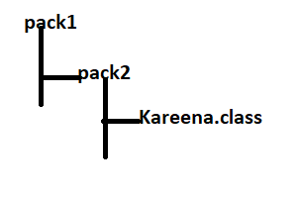
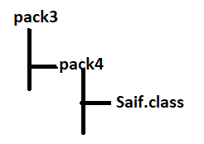
C:\>javac -d . Kareena .java D:\> javac -d . Saif.java // CE : can not find symbol // symbol: class Kareena //location : class pack3,pack4.Saif D:\>javac -d . -cp c : Saif.java E:\> javac Akhil.java // CE : can not find symbol // symbol: class Saif //location : class Akhil E:\> javac -cp D:Akhil.java; E:\> Java Akhil ; RE: NoClassDefFoundError: pack3.pack4.Saif; E:\>java -cp .;D: Akhil ; RE: NoClassDefFoundError: pack3.pack4.Kareena; E:\>java -cp .;D: ;C: Akhil ; F:\> java –cp E:; D:;c: Akhil ; | C: package pack1.pack2; public class kareena { public void m1() { sopln(“Hallo Saif can u plz set hellotune ”); } } | D: package pack3.pack4; Import pack1.pack2.Kareena public class Saif { public void m2() { Kareena k = new Kareena(); k.m1(); sopln(“Not possible because I am in SCJP class ”); } } | E: Import pack3.pack4.Saif public class Akhil { public static void main(String[] args) { Saif s = new saif(); s.m2(); sopln(“Hello Kareena can I help you ”); } }

Slide 6
Conclusions :
If any location created because of package statement that location should be resolved by using import statement , and base package location we have to update in classpath
Compiler will check only one level dependency whereas JVM will check all levels of dependency .
In classpath the order of location is important and JVM will always consider from left to right until required match available
Java -cp D:;C:;E: Nagavalli
// ouput== D:Nagavalli
Java -cp E:;D:;C: Nagavalli
// output = E:Nagavalli
C: public class Nagavalli{ p s void main(String[] args){ sopln(“C:Nagavalli”); } } | D: public class Nagavalli{ p s void main(String[] args){ sopln(“D:Nagavalli”); } } | E: public class Nagavalli{ p s void main(String[] args){ sopln(“E:Nagavalli”); } }

Slide 7
Need Of Jar File :
All third Party software plugins are by default available in the form of jar file only .
All dependent classes are available in servlet –api . Jar we have to place this jar file in classpath to compile a servlet program
To run a jdbc program all dependent classes are available in ojdbc14.jar to runjdbc program we have to place this jar file in classpath.
To use Log4j in our applications dependent classes are available in log4j.jar . We have to place this jar file in the classpath then only log4j application can run
Various commands for jar file
To create jar file(zip file) :
jar -cvf javapractice.jar Test.class
jar -cvf javapractice.jar A.class B.class C.class
jar -cvf javapractice.jar *.class
jar -cvf javapractice.jar *.*;
2. To Extract jar file(unzip file) :
Jar -xvf javapractice.jar

Slide 8
3. To display table of contents :
Jar -tvf javapractice.jar
Service Provider’s Role
demo program for jar file
Public class DurgaColorfulCalc
{
public static void add(int x,int y ){
sopln(x*y);
}
public static void multiply(int x,int y ){
sopln(2*x*y);
}
}
// java c DurgaColorfulCalc.java
jar -cvf durgacalc.jar DurgaColorFulCalc.class
// Jar file is ready

Slide 9
Using Jar file in Client Program .
Client’s Role
He downloaded the jar file and placed in D: of clients memory
class Bakara
{
public static void main(String[] args){
DurgaColorFulCalc.add(20,10);
DurgaColorFulCalc.multiply(20,10);
}
}
C:\durgaclasses> javac Bakara.java // CE
C:\durga-classes> javac -cp D:Bakara.java
C:\durga-classes>javac -cp D:\durgacalc.jar Bakara.jar;
C:\durgaclasses>java Bakara; // RE : NoClassDefFoundError: DurgaColorFulCalc
C:\durgaclasses>java -cp D: Bakara;
// RE : NoClassDefFoundError: Bakara
C:\durgaclasses>java -cp D: Bakara;
// RE : NoClassDefFoundError: DurgaColorFulCalc
C:\durgaclasses>java -cp D:\durgaclac.jar Bakara;

Slide 10
Note:
To place .class file in class path just location is enough but to make jar file available in classpath location is not enough compulsory we have to include name of the jar file also .
Shortcut way to place jar file in classpath
Jdk=>jre=> lib=>ext=> *.jar
If we place jar file in the following location then all classes and interfaces present in the jar file by default available to java compiler and jvm we are not required to set classpath explicitly
System Properties :
For every system some persistent information will be maintained in the form of system properties these include name of the OS java version JVM vendor User country . Etc .
Demo program to print system properties .
Import java.util.*
Class Test
{
public static void main(String[] args){
Properties p = System.getProperties();
p.list(System.out);
}
}

Slide 11
We can system properties explicitly from the command prompt by using -D option
Java –DDurga = OCJP Test
// To set a system property
Space is not allowed between option value and property name
The main advantage of setting system property is we can customize behaviour of java program
class Test {
public static void main(String[] args){
String course = System.getProperty(“course”);
if(course.equals(“scjp”))
sopln(“Scjp Information”);
else
sopln(“Other Course information ”);
}
}
Java –Dcourse = scjp Test
// output : scjp information;
Java -Dcourse = scwcd Test
// output : Other course information

Slide 12
Jar vs war vs ear
Jar :
It contains a group of .class files
War:
Web-Archive
A war file represent 1 web application which contains servlets jsps Html js file etc.. . The main advantage of maintaining web application in the form of war file is project deployment project delivery and project transportation will become easy .
Ear:
EnterPrise-Archive :
An ear file represents one Enterprise application which contains servlets jsps EJBs Jms components etc..
Note:
In general Ear file represent a group of group of war files and jar files

Slide 13
Web application Vs Enterprise Application :
A web-application can be developed by only web related technologies like servlets, jsps, html,css,js,xml etc.. . Example Online Library management System Online Shopping Cart .
An EnterPrise Application can be developed by any technology from java j2ee like servlets jsps , EJBs , JMS components etc..
Banking application . Telecom based Application
J2EE compatible Application is Enterprise Application
Web Server vs Application Server:
Web server provides Environment to run web applications . Web server provides support for web related technologies like servlets jsps html etc.
Example tomcat
Application server provides environment to run Enterprise Applications Application server can provide support for any technology from java J2EE like servlets jsps EJBs ,JMS components etc.. Web logic web sphere Jboss etc..
Note
Every application server contains inbuilt webserver to provide support for web related technologies .
J2EE compatible server is application server .

Slide 14
How to create executable jar file ?
Import java.awt.*;
Import java.awt.event.*;
public class JarDemo
{
public static void main(String[] args)
{
Frame f = new Frame();
f.addWindowListener(new WindowAdapter()
{
public void windowClosing(WindowEvent e )
{
For(int i = 1; i<=10;i++)
sopln(“I am closing window : ”+ i);
System.exit(0);
}
});
f.add(new Label(“I can Create Executable jar File !!! ”));
f.setSize(500,500);
f.setVisible(true);
}
}

Slide 15
Manifest.MF
Main-class : JarDemo
-
+++=========================================================================================
Javac JarDemo.java
Generated .class files :
JarDemo.class, JarDemo$1.class
Jar -cvfm demo8.jar manifest.MF JarDemo.class JarDemo$1.class
Execute // Run the jar file
Java –jar demo8.jar
Even we can run the jar file by === > Double click on the excutable jar

Slide 16
How many ways are available to run java program ?
We can run the java program in the following ways .
From command prompt we can run run .class file with java command
java JarDemo
From command prompt we can run run .jar file with java command
java –jar demo8.jar
3. By double clicking the jar file
4. By double clicking a batch file .

Slide 17
Batch File :
A batch file contains a group of commands whenever we double click a batch file then all commands will be executed one by one in the sequence
abc.bat
Java -cp C:\durga-classes JarDemo

Slide 18
Difference between path and classpath
Classpath :
Classpath describes the location where required .class files are available . Java compiler and Jvm will use classpath to locate the required classpath . If we are not setting classpath then our program may not compile and may not run
Path
Path describes the location where required binary executables are available . If we are not setting path then javac and java commands won’t work
Java set path = C:\Program Files\Java\jdk1.6.0_11\bin

Slide 19
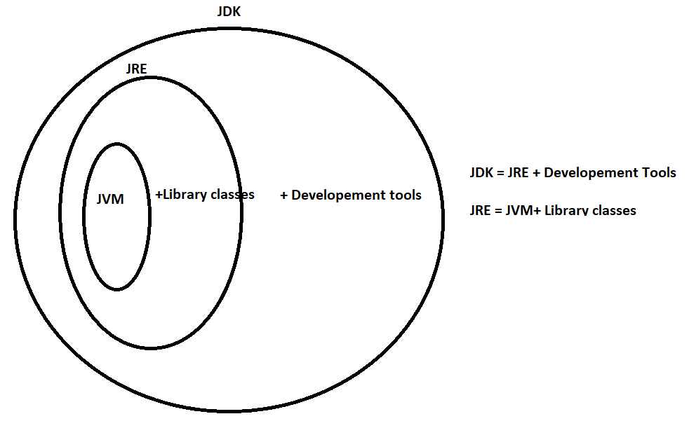
Difference between JRE ,JDK and JVM
JDK Java Development Kit
JdK provides Environment to develop and run java application
JRE : Java Runtime Environment:
JRE provides environment to run java application
JVM : Java Virtual Machine
JVM is responsible to run java program line by line hence it is an Interpreter

Slide 20
JVM is the part of JRE whereas JRE is the part of JDK
Note
On the developers machine we have to install JDK whereas on the client machine we have to install JRE
Difference between Java , javaw, javaws?
Java :
We can use java command to run a java class file where sops will be executed and corresponding output will be displayed to the console .
JavaW : java without console output :
We can use javaw command to run a java class file where sops will be executed but corresponding output won’t be displayed to the console .
In general we can use javaw command to run GUI based application .
Javaws : java Web start utilities :
We can use javaws to download a java application from the web and to start its execution we can use java ws command as follows
Javaws –jnlp -url It downloads the application from the specified URL and starts execution . The main advantage in this approach is every end user will get updated version and enhancement will become easy because of Centralised control .

